Slide 1
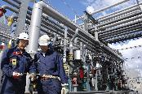
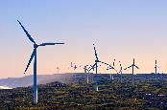
End of Year Industry Showcase
8 December 2022 | Customs House Brisbane

Slide 2
In our journey for collaboration to drive change for our world, we ask that all people that walk, work and live on traditional lands be respectful of all cultures and traditions and work together as one for a solution to climate change.
H2Q Acknowledges the traditional custodians of country throughout Australia, and their continuing connection to land, sea, culture and community.

Slide 3
H2Q Industry Partners

Slide 4
Program
Welcome Address
Queensland Government Update
H2Q Working Groups Presentation
H2Q Industry Awards
Inaugural Hydrogen Connect Summit 2022 - Highlights Reel
Official Launch: Industry White Paper
Official Launch: 2nd Annual Hydrogen Connect Summit 2023
Official Launch: 2023 Summit Sponsorship Prospectus
Close & Networking Drinks

Slide 5
Event Supporters
Notes:
ACCIONA Energía is the largest 100% renewable energy company with no fossil legacy in the world. It has 11.2GW of renewable energy and commercial operations in 20 countries. ACCIONA Energía has been in Australia for 20 years and offers a complete portfolio of tailor-made energy solutions for its corporate and institutional clients to meet their decarbonisation goals.

Slide 6
Event Supporters
Notes:
As the consulting arm of the Worley group, Advisian’s purpose is ‘challenge complexity into shaping a sustainable future’. Advisian are leaders in navigating the energy transition having competed over 3,600 energy transition projects; a recent example being the strategic study enabling Queensland’s hydrogen production and export opportunities.

Slide 7
Industry Awards sponsors

Slide 8
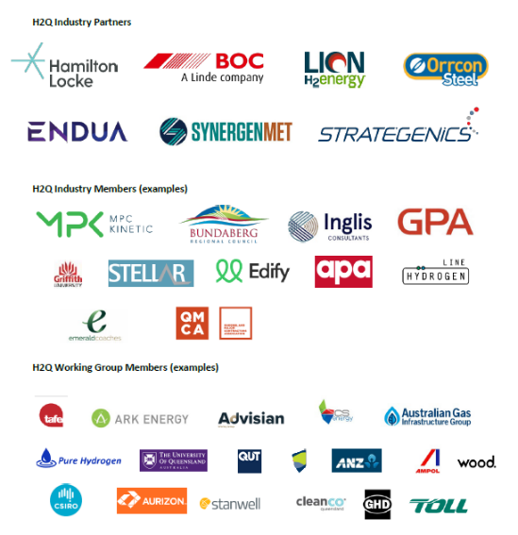

Slide 9
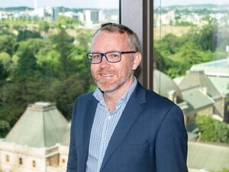
2022 in review
Chris Shaw
Deputy Director-General, Hydrogen, Dept of Energy and Public Works
Chris Shaw is Deputy Director-General for Hydrogen within the Department of Energy and Public Works. He leads a newly created Division within the Department that has responsibility for leading strategic planning and coordination for the hydrogen industry across Queensland Government. He works closely with industry, counterpart agencies and the Queensland Government’s Hydrogen Taskforce to ensure policy, planning and regulatory activities are effectively integrated and enable value for the Queensland public from the rapidly emerging hydrogen industry.
Notes:
Chris has a successful track record of industry development and facilitation, most recently as Executive Director – Resources Policy within the Queensland Government, as well as relevant experience leading regulatory reform for the onshore gas industry in the Northern Territory and as a strategy and approvals consultant to the resources and infrastructure sectors across Australia.

Slide 10
H2Q’s Working Group update
Behnoud Tahmesby
H2Q Director – Working Groups
Supply Chain
Policy and Advocacy
Training, Education & Skills
Safety Regulations and Compliance
Start Ups & Innovation
Notes:
BEHNOUD Our working group members are all volunteers who meet regularly to identify and discuss the challenges that industry face.
Tonight two of our groups will provide an update on their successes in 2022 and their plans for 2023
H2Q deeply appreciate the give away of the individuals of their time and expertise and as a toke n of our deep gratitude we are tonight, recognising each group member with a certificate of appreciation and a one year, H2Q independent membership –for which they receive their members pin for the next 12 months.
Introducing the working group leads and their working froups

Slide 11
H2Q Working Group 1 – Education, Skills and Training
GOALS AND OBJECTIVES
QLD educators stand at the cutting edge of hydrogen skill development
QLD industry & workforce has access to world-class hydrogen training
Collaboration is occurring to ensure skilling solutions meet the needs of the workforce
QLD stakeholders are positioned to Influence the Vocational Education and Training system to ensure nationally accredited training package product development is occurring across all sectors

Slide 12
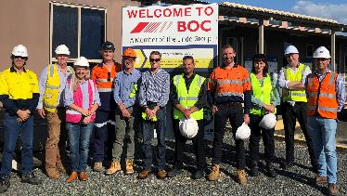
2022 Achievements
Establishment of Sub Committees
Knowledge sharing
Practical tours of Hydrogen manufacturing
Safety Code Of Practice
Preparing QLD emergency responders for hydrogen vehicles
Training & Assessment Resource Development (19 units)

Slide 13
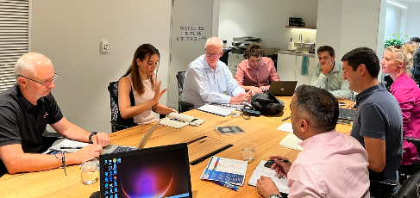
2023 WG 1 Plans and Ideas
TAFE developing 10 units to manufacture H2 funded by DESBT
TAFE & CQU developing nine units manufacture H2 funded by DESBT related to the three UEG Skills Sets
H2 Safety
Injecting H2 for Distribution
Monitoring H2 Control Systems
Ammonia Production Skills
Provision of other H2 Related Training & Skills
Learning Library
Hydrogen & Renewables Awareness
Site Visits

Slide 14
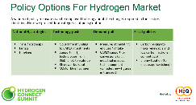
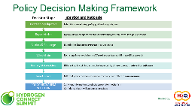
H2Q Working Group – Policy and Advocacy
2022 ACHIEVEMENTSv
Forming a Policy working group
Delivering an industry workshop, as part of the Summit activities, focused on Market barriers for the hydrogen industry in Queensland and policy tools to address these.

Slide 15
2023 Policy and Advocacy group
In 2023 – following up on the workshop findings, the group will be focusing on ‘Offtake incentives models and mechanisms’:
Investigating offtake incentives models/mechanisms available and their application in Queensland context
Engaging with the industry/ H2Q members to test which incentives/models would work best
Publishing findings in a white paper and taking it to the Summit 2023.

Slide 16
Thank you for your contribution to the H2Q working groups for Supply chain and Policy and Advocacy
Rainer Hagedorn | Nigel Lott | Paul Rigo | Greg Perkins
Tim Lloyd-Smith | Ann Dadis
Ekaterina Milne | Thomas Koller | Nigel Lott | Ariel Elboim
Notes:
Names of all group members are to be added to this slide for Supply chain, Startups and Policy and Advocacy

Slide 17
Thank you for your contribution to the H2Q working groups for Skills and Training working group
Wayne Lee | Simon Minge | Peter McKavanagh | Bhenoud Tahmesby
David Jiear | Amanda Carey | Jeff Muir | Malcolm Garrick
Liana Wortley | Rebekah Jensen | Adam Pennicott | Nicholas Wing
Jakes Jacobs | Peter Ferri | Brian Inglis | Robert Puckridge
Marcello Riotto | Scott Travers | Clint Butler | Kent Vickers
Camilla Elmes | Dr Mike Logan | Greg Mitchell | Lyndal Carter
Donna Playford | Mark Robertson | Richard Cary | Mathew Cooper
Andrew Deering | Dr Georgina Davis

Slide 18
Thank you for your contribution to the H2Q working group Safety, Regulations and Compliance
Alex Farquhar | Thomas Koller | Delene Kock | Derek Cross
Jarrod Irving | Guarang Joshi | Diane Hinson | Will Spencer
Daniel Krosch
Notes:
Names of the safety and regs group

Slide 19
H2Q Inaugural Industry Awards
Inviting Industry to recognise and celebrate the success of projects, business and outstanding individuals that
Promote industry
Develop supply chains
Are working hard to overcome the paradox for hydrogen advancement
2022 relevant
Demonstrate how collaboration and partnership can achieve outcomes

Slide 20
Industry Awards sponsors

Slide 21
Outstanding Project
for Advancement
of the Hydrogen Industry
Proudly sponsored by

Slide 22
The BOC / BP / QFLEET
Brisbane Refuelling Project
Proudly sponsored by

Slide 23
BOC SLIDES HERE

Slide 24
Industry Choice
Hydrogen Startup
Proudly sponsored by

Slide 25
ENDUA
Proudly sponsored by

Slide 26
Stored renewable energy.
Available day or night.
hello@endua.com

Slide 27
Industry Choice
Outstanding Woman
in Hydrogen
Proudly sponsored by

Slide 28
Diane Hinson
Proudly sponsored by

Slide 29
Outstanding Contribution
to Hydrogen Queensland
Proudly sponsored by

Slide 30
Brian Inglis
Ekaterina Milne
Proudly sponsored by

Slide 31
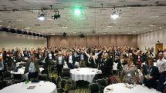
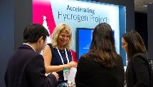
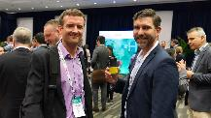
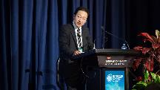
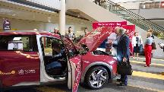
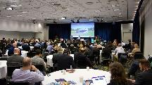
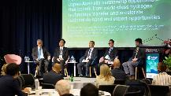
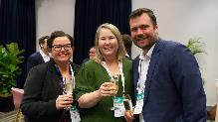
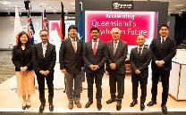
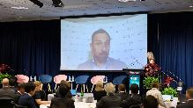
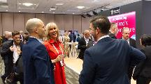

Slide 32
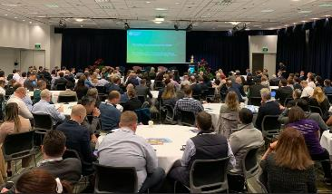
Official Launch: Industry White Paper
The object of this paper is to present developments after the Inaugural Hydrogen Connect Summit 2022, to address questions raised by delegates requiring further answers at that time, to propose further ideas raised since COP 27, and to discuss new State and Federal announcements.
As part of H2Q’s commitment to industry, further ideas raised during future Hydrogen Connect Summits will be investigated and explored in forthcoming white papers and in consultation with various working groups, and Federal and State Governments.
White Paper for the Transformation of the Hydrogen Economy in Australia
By industry, for industry
Published by H2Q Hydrogen Queensland - Heidi Breen, CEO, H2Q

Slide 33
Official Launch: 2nd Annual Hydrogen Connect Summit 2023
BACK BY POPULAR DEMAND!
Following a hugely successful 2022 Summit, H2Q is proud to announce the return of our 2nd Annual Hydrogen Connect Summit 2023.
6-7 September 2023
Brisbane Convention & Exhibition Centre
You will once again be presented with a world class program which has been designed BY INDUSTRY, FOR INDUSTRY. Action is what drives our ethos, and as an industry/policy influencer and a true “not for profit” organisation, H2Q is taking ownership of the conversation.
Greater Attendance 600+ Delegates
Larger Program
100+ Speakers
B2B Investment Forum
More Panels Case Studies Workshops
Tech Tours
More International VIP’s from Europe & Asia
Increased Business Matchmaking
Pitch Battle for start-ups
Larger Exhibition
Don’t miss the opportunity to participate in Queensland and Australia’s largest hydrogen program

Slide 34
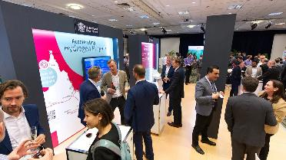
Official Launch: 2023 Summit Sponsorship Prospectus
In addition to the official Summit launch, H2Q is very proud to release the 2023 Summit Sponsorship Prospectus.
This is your chance to partner with Hydrogen Connect Summit and amplify your presence in the hydrogen supply chain.
Ensure your product or service offering features prominently with an audience desiring solutions to achieve their hydrogen fueled future.
Sponsorship support of the Summit is key so we can keep delegate fees down.
Contact: Phil McDermott
Marketing & Sales Director - 2nd Annual Hydrogen Connect Summit 2023
p: 0491 209 066 | e: sponex@hydrogenconnect.com.au

Slide 35
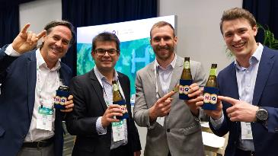
Thank you

Slide 36
H2Q Industry Partners

